Slide 1

Search Graphs
Problem Space Representation

Slide 2
Search Graphs: Waypoints
With tiles, terrain and search topology (search space) are the same – but when our terrain is continuous (non-discrete), we must create a graph to represent the space based on its geometry and dimensionality (e.g.2D or 3D).
Creation Graphs – Approaches
Hand-crafted
Just the way you want, but time consuming
Automated
Also works well for dynamic terrain
Care needed to avoid edge cases
Sadly, many graph generation techniques for 3D spaces are trade secrets.

Slide 3
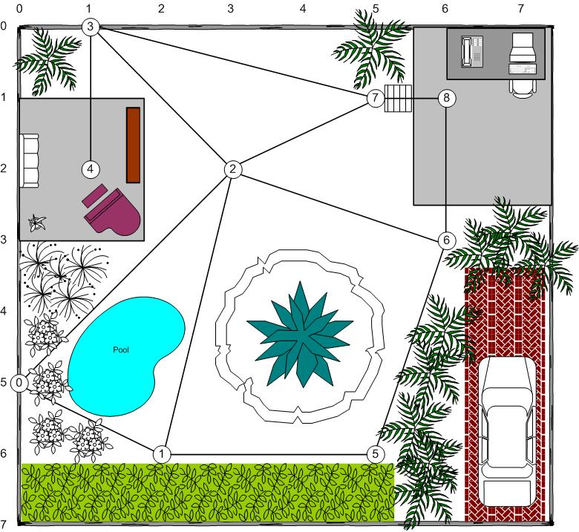
Search Graphs: Waypoints
With tiles, terrain and search topology (search space) are the same - but we can also represent the space with a graph based on the geometry (2D or 3D).
Waypoint Graphs
Vertices are points in space (waypoints)
Edges are line segments with length
Returns line-based path, point-to-point
Unfortunately, waypoint graphs often suffer from suboptimal and/or unnatural looking paths due to poor placement or complex geometry (e.g., jutting walls or objects).

Slide 4
Search Graphs: Navigation Meshes
Rather than using points in space (waypoints) for our vertices, we can instead use polygons (usually) to represent out search space (terrain).
Navigation Meshes
Vertices are polygons
Edges are portals between polygons
Returns a polygon channel
Navigation meshes usually require additional techniques to develop a path from the channel ( such as funneling.)

Slide 5
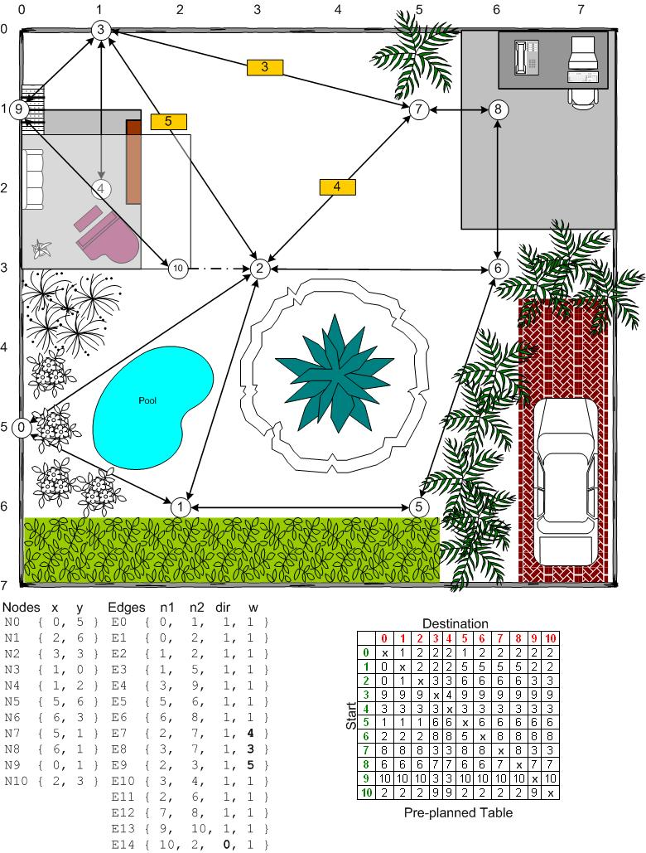
Graphs: Preplanning Tables
Preplanning Benefits:
Extremely Fast (at search time)
Memory friendly (at search time)
Preplanning Drawbacks:
Not dynamic
Exponential memory
Mitigation Techniques:
Smaller data types
Relative indexing

